Slide 1

EEE Session

Slide 2
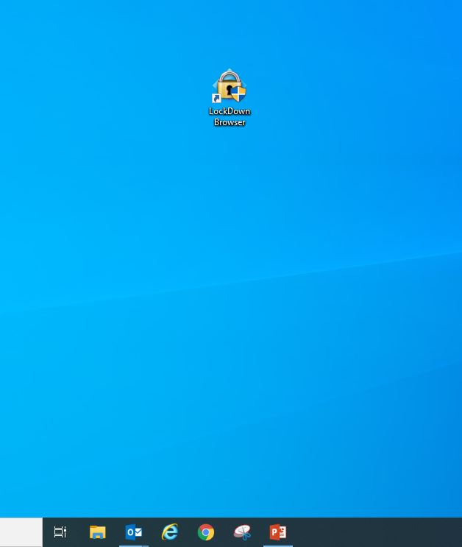
Click here

Slide 3
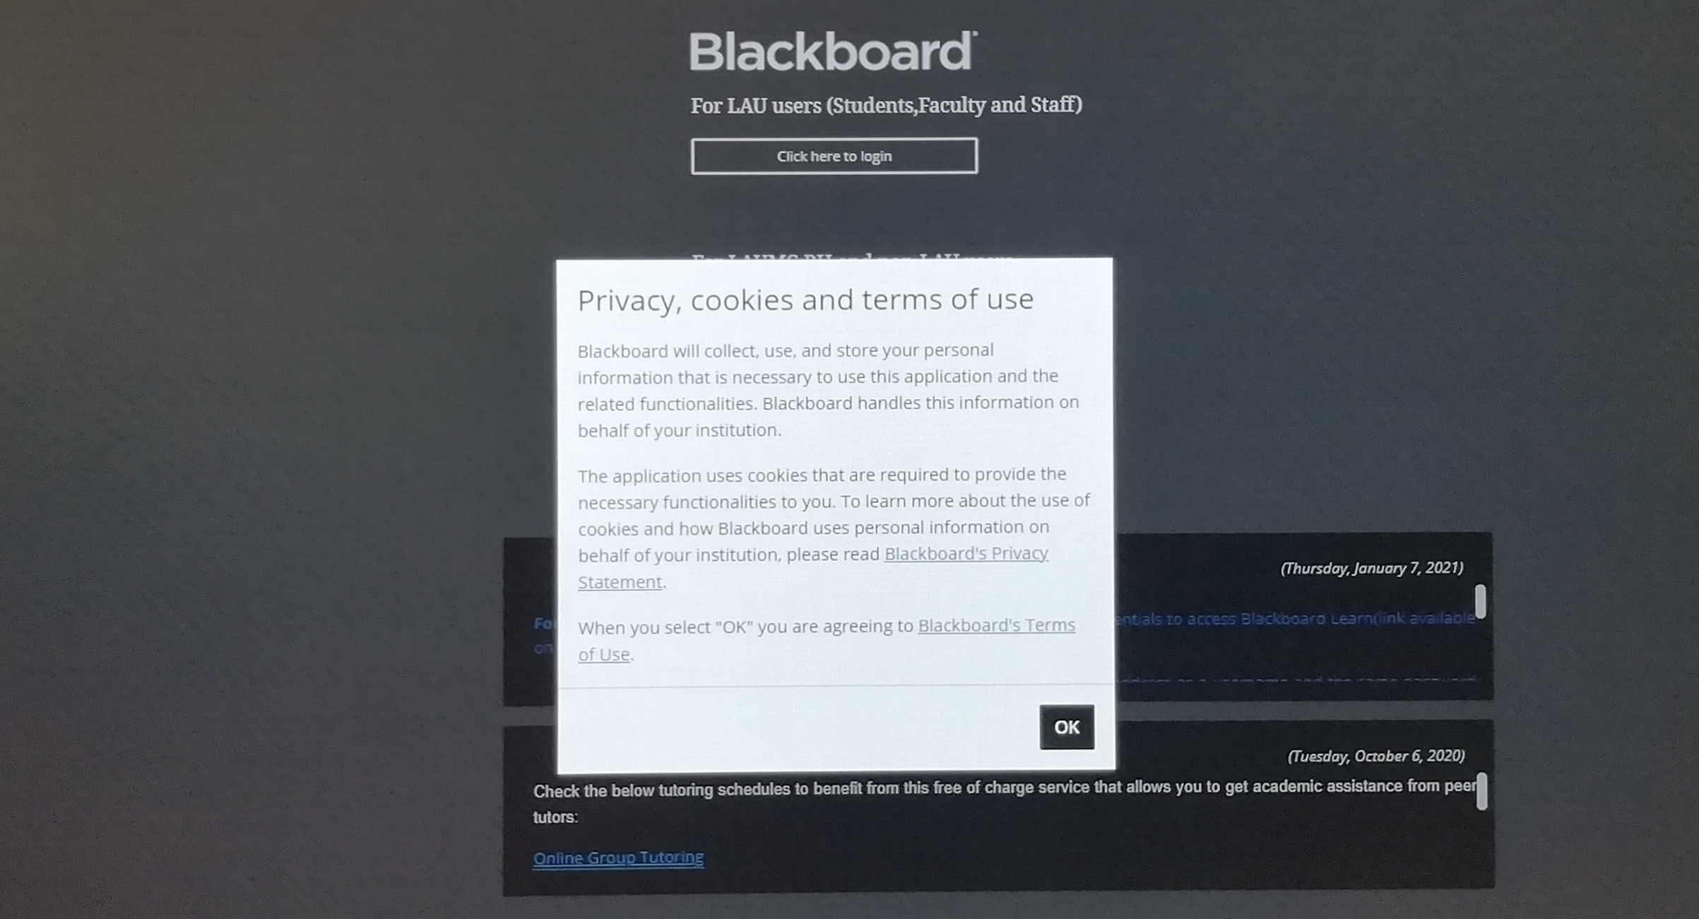
Click here

Slide 4
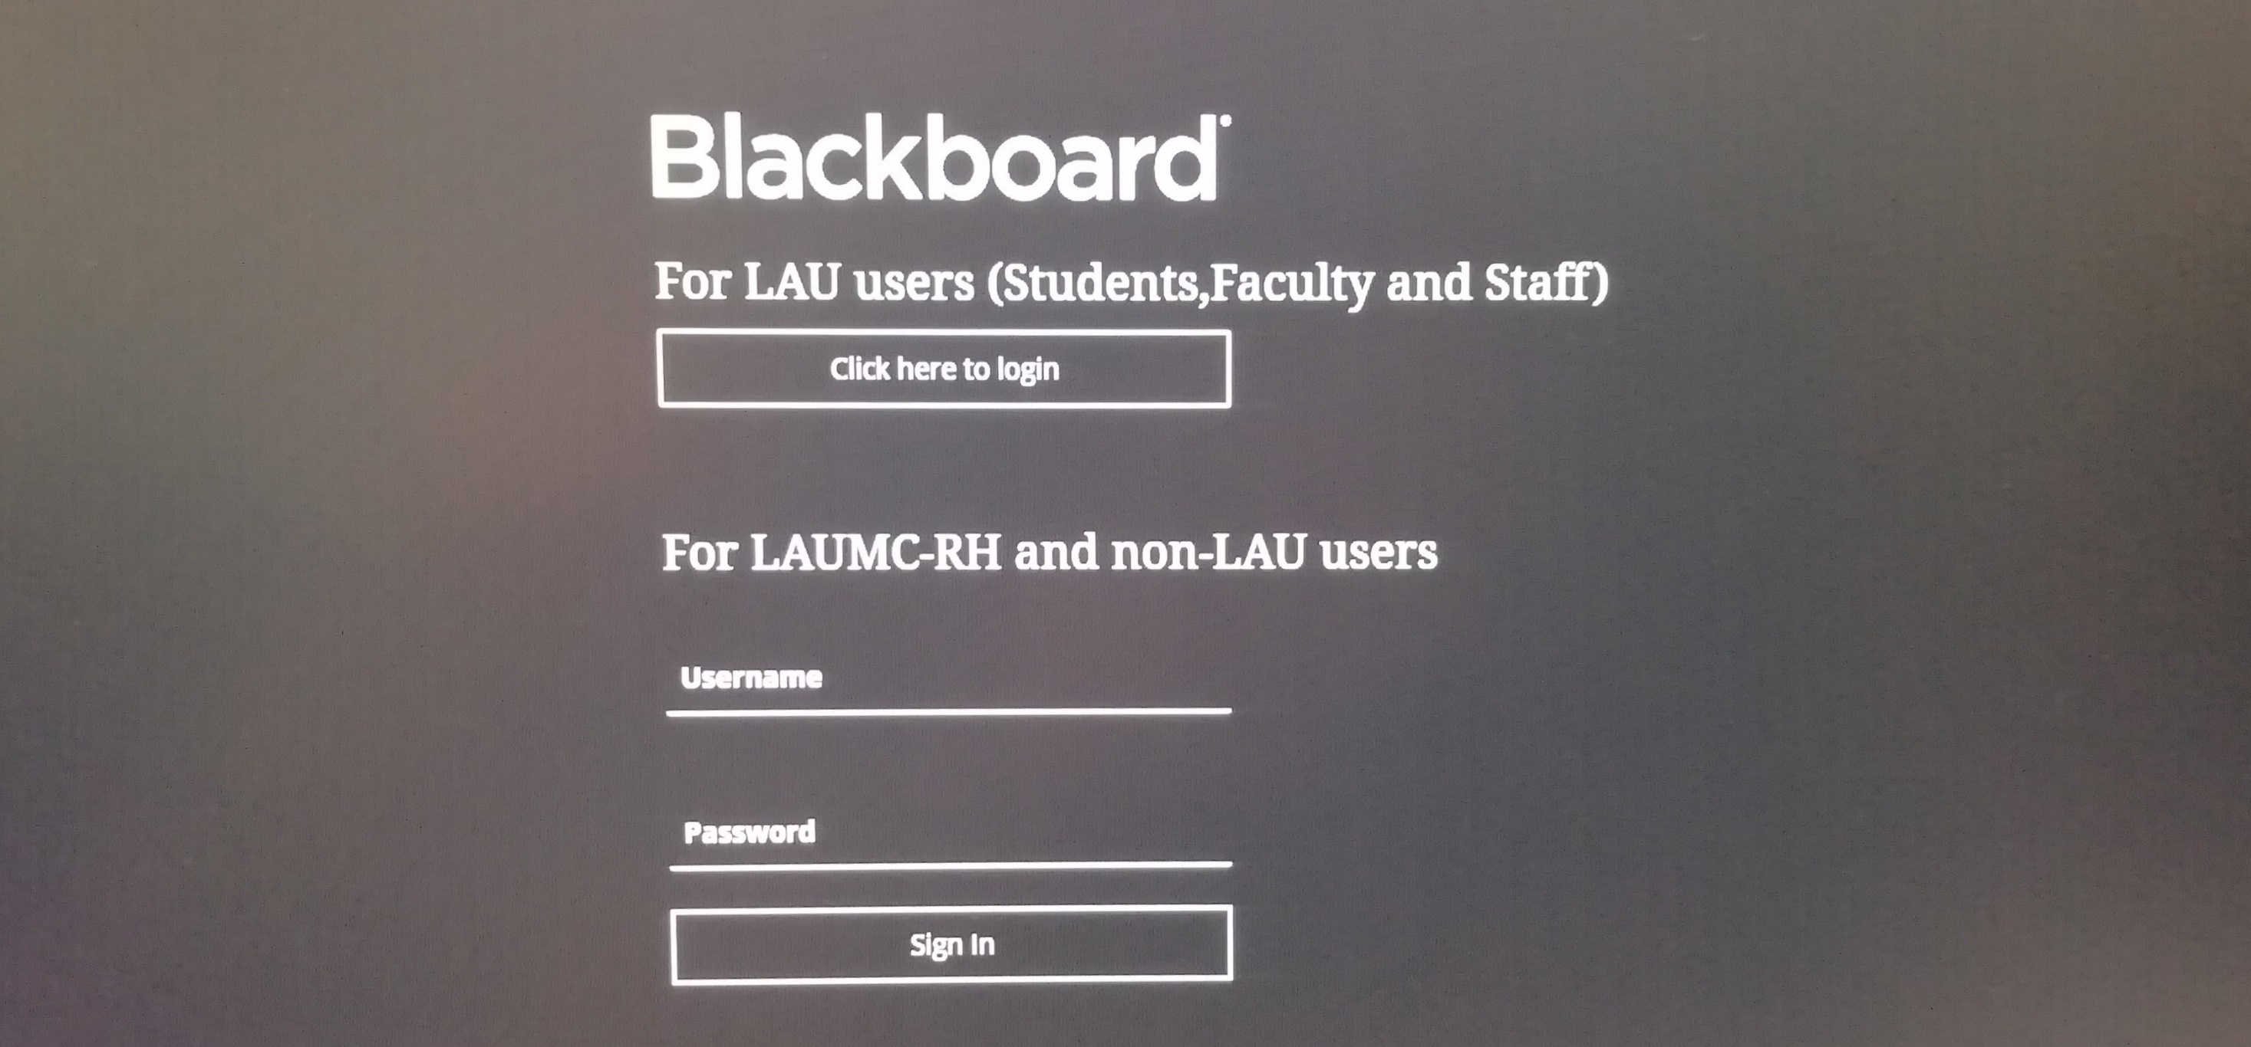
Click here

Slide 5
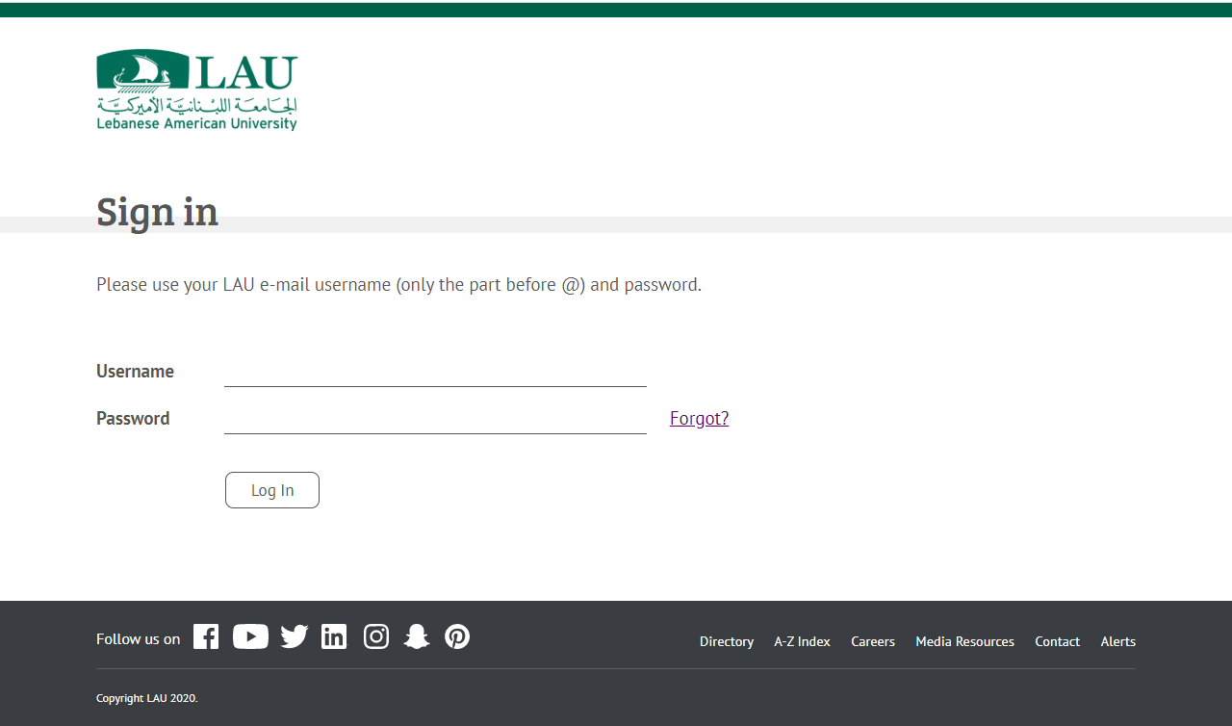
Type your username
Type your password
Click here

Slide 6
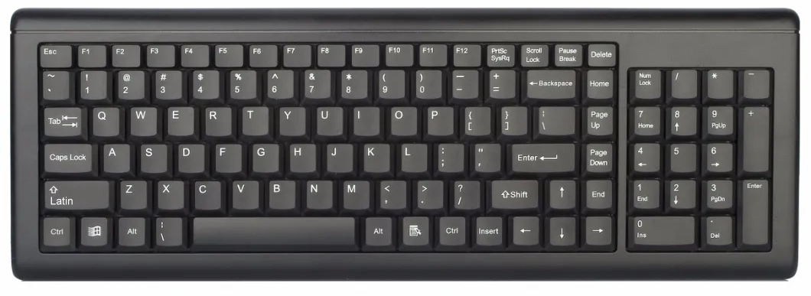
~
!
@
#
$
%
^
&
*
_
?
To write any of these special characters hold the LATIN (SHIFT) button and press the needed character.
To write a capital letter hold the LATIN (SHIFT) button and press the needed character.
We would suggest to avoid using the Caps Lock button.

Slide 7
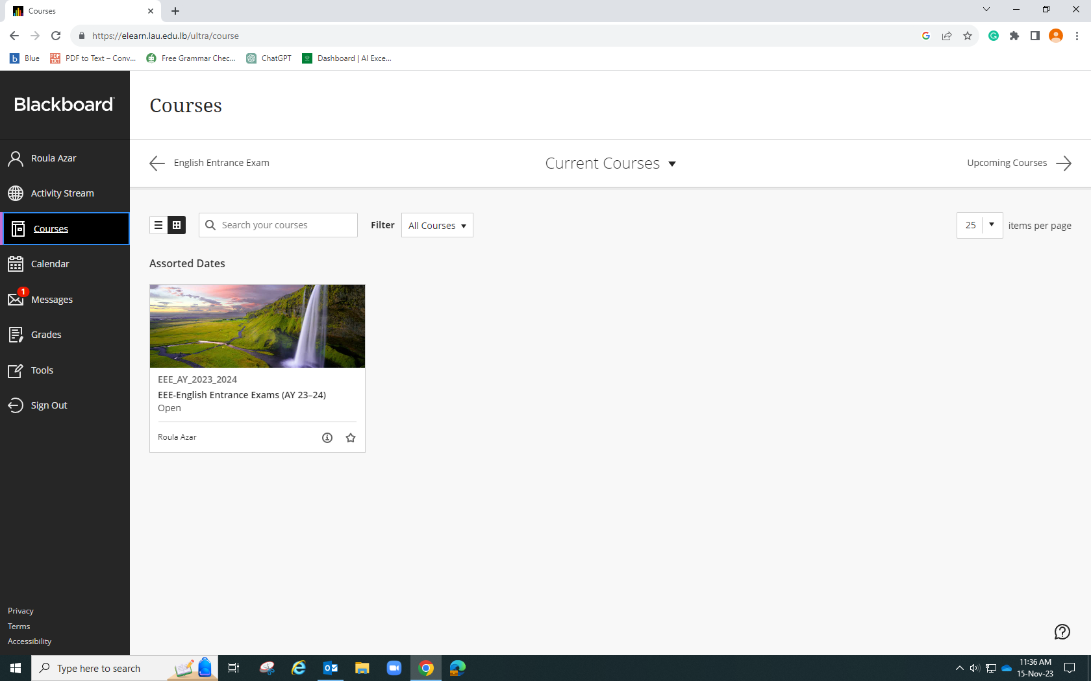
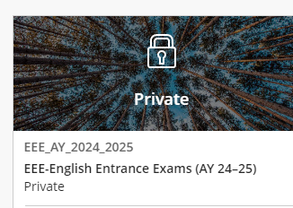
Step 1 :Click here
Step 2 :Click here

Slide 8
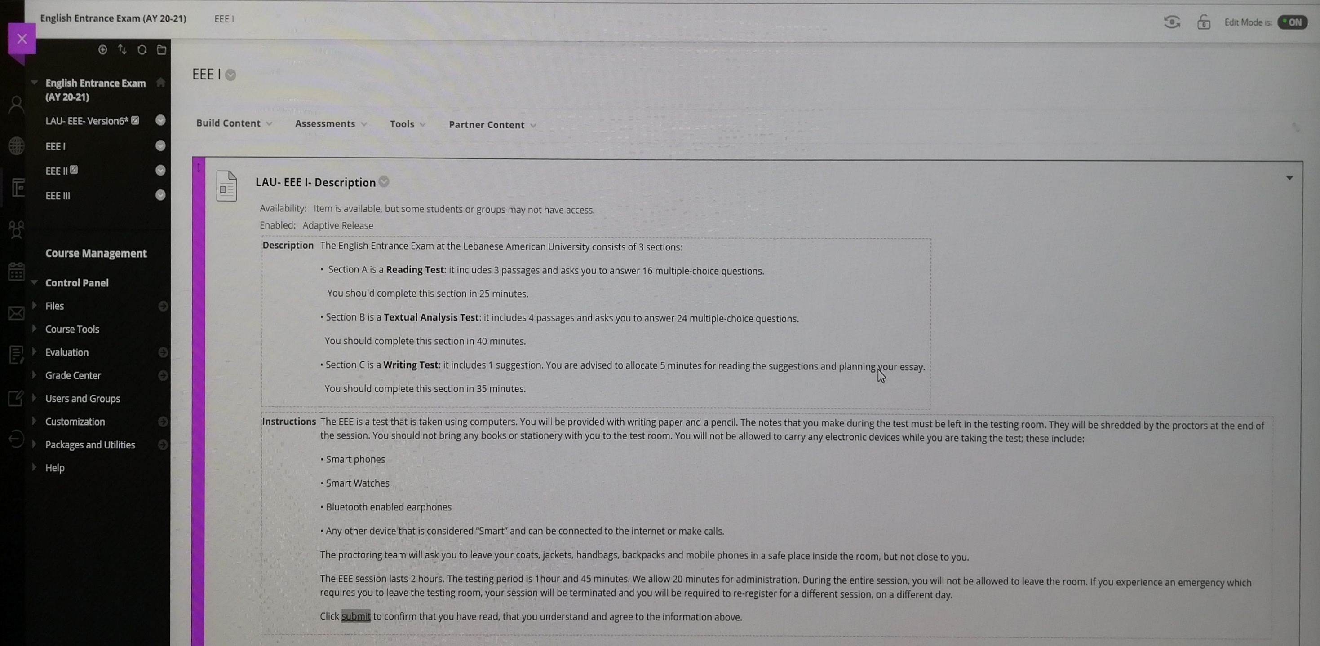
Click on the proper exam

Slide 9
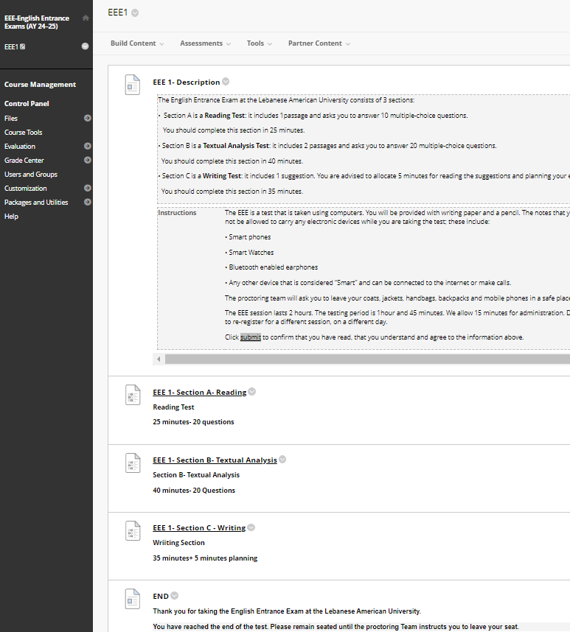

Slide 10
Click here

Slide 11
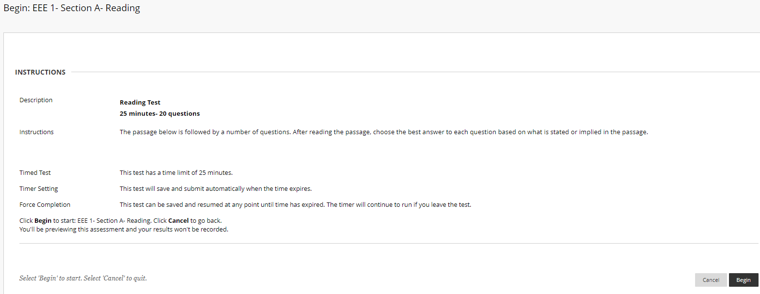
Read Carefully!
Click here

Slide 12
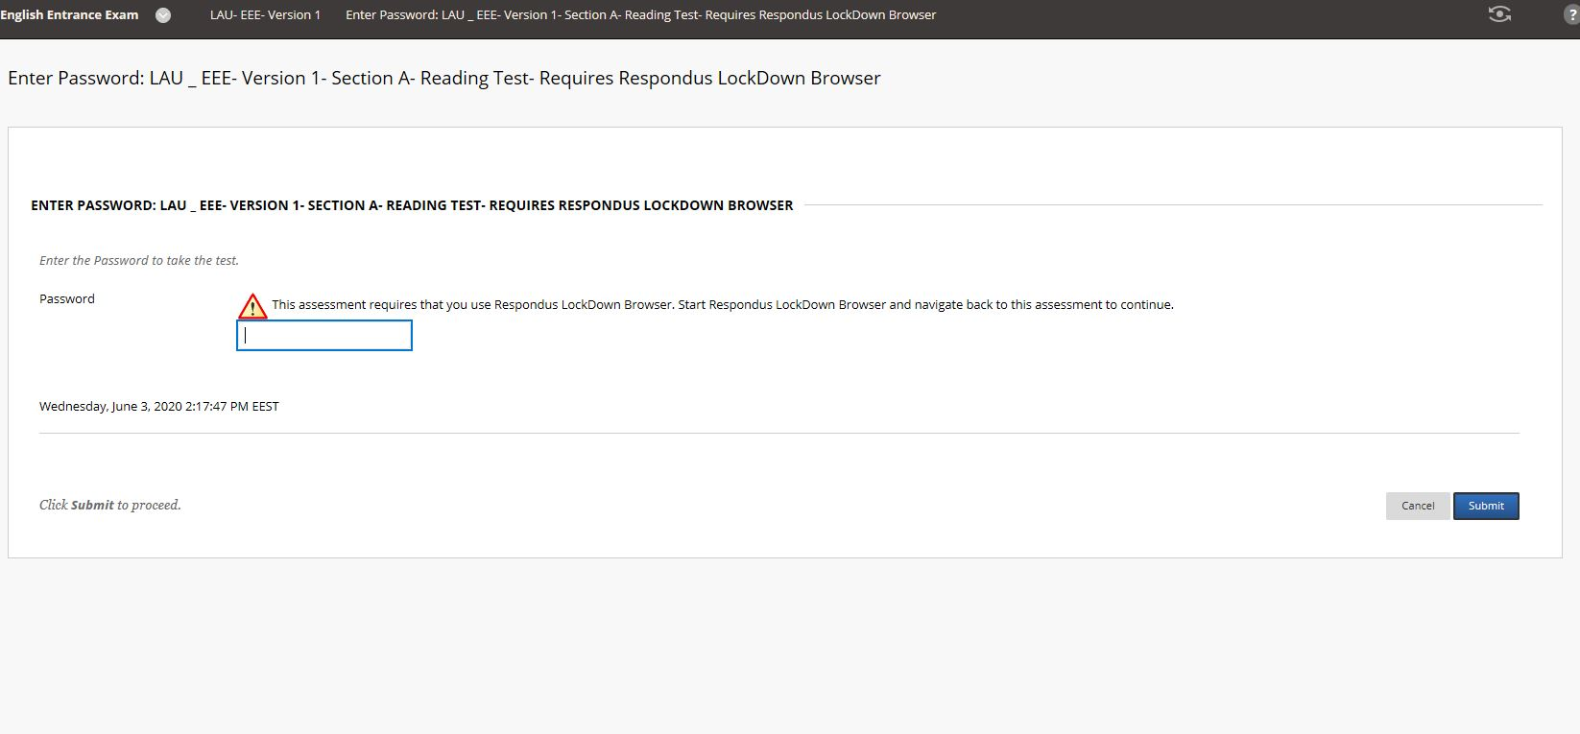
Enter password provided by proctors

Slide 13
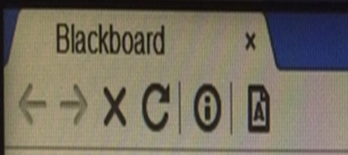
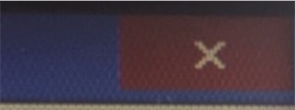

Do not use any navigation button
Do not use this close button
ATTENTION
Before leaving the exam
click here

Slide 14
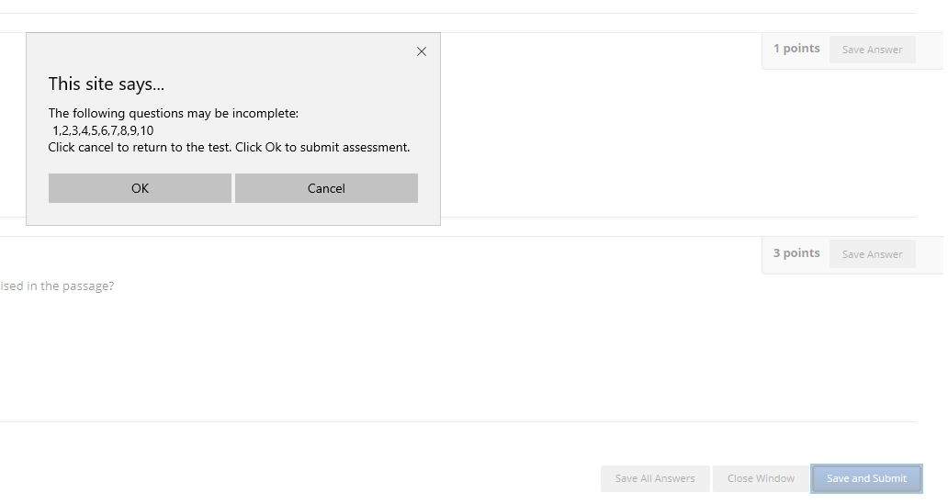
Click OK to exit the exam
Click Cancel to go back to the incomplete questions
Caution: This will not take you back to the exam!

Slide 15
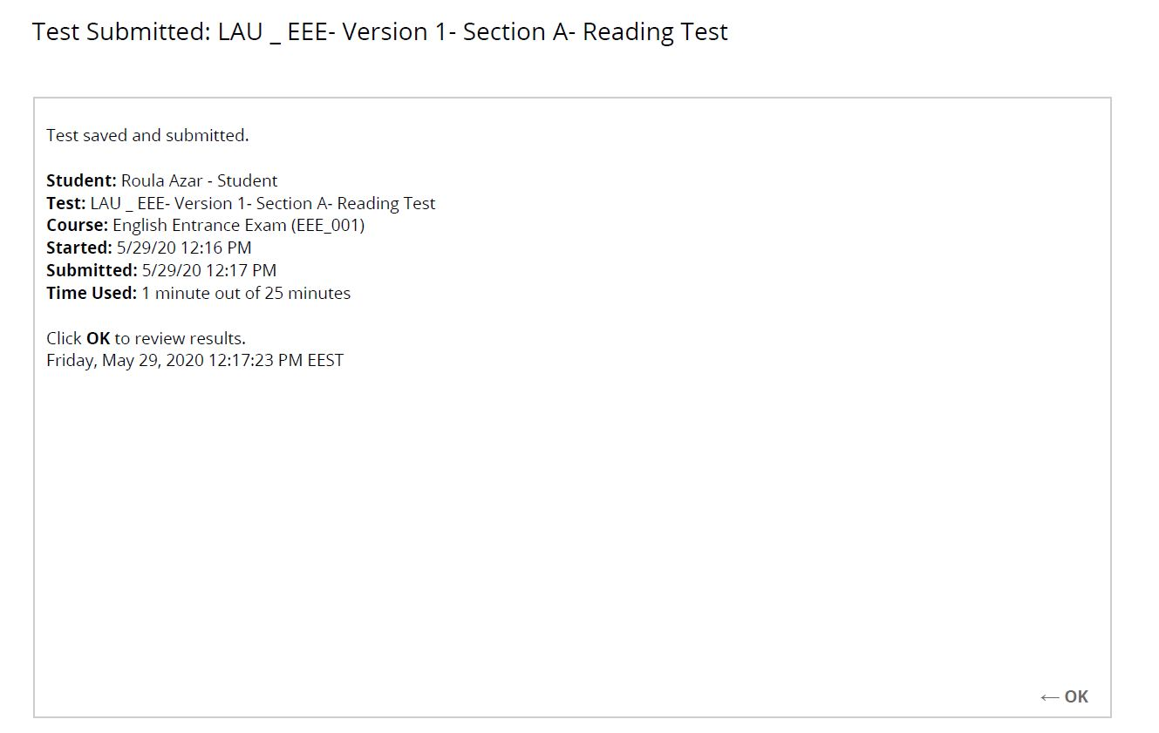
Click here

Slide 16
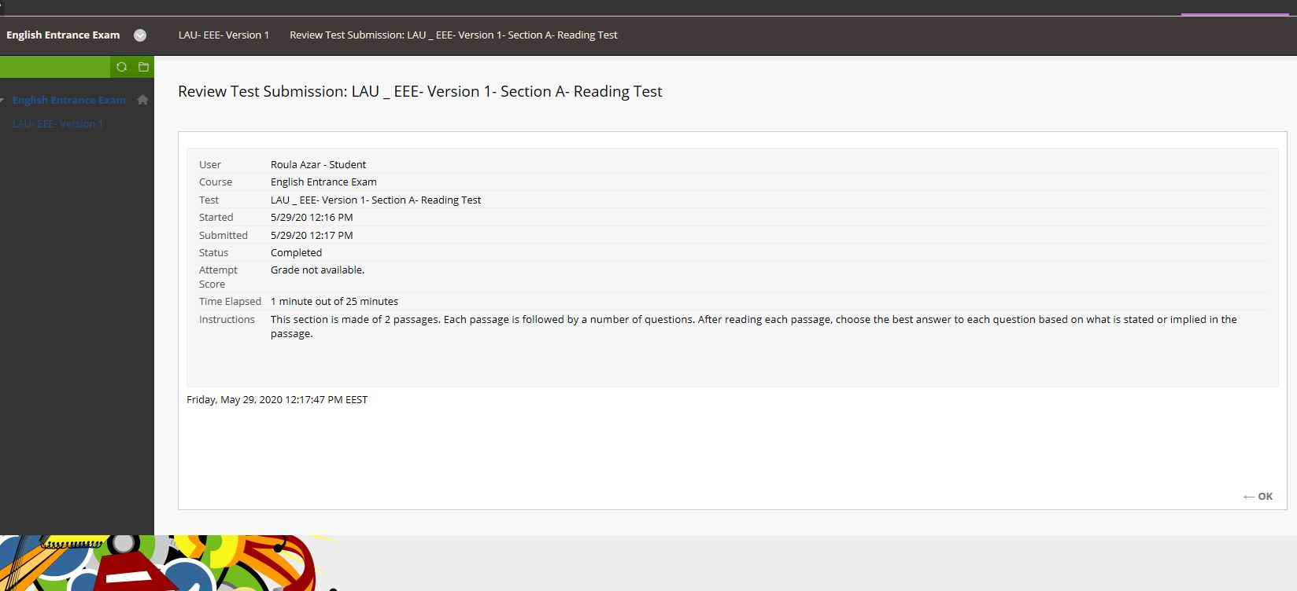
Click here

Slide 17
Click here

Slide 18
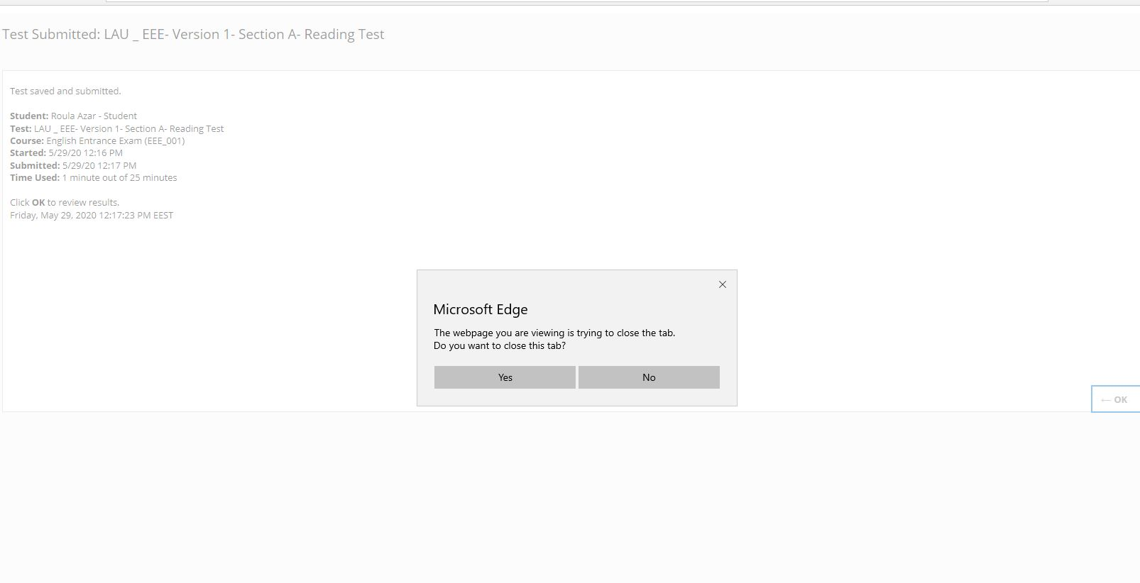
Click here

Slide 19
Click here

Slide 20
Click here

Slide 21
Click here

Slide 22
Type your username
Type your password
Click here

Slide 24
Step 1 :Click here
Step 2 :Click here

Slide 25
Click on the proper exam

Slide 26
Click here

Slide 27
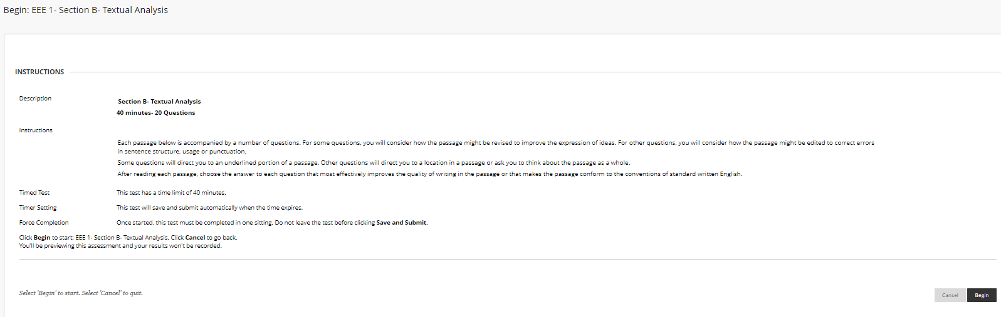
Click here

Slide 28
Enter password provided by proctors

Slide 29
Password:
Ask for scratch paper/pen if you need them for
Section C

