Slide 1


Lebanese American University
Executive Vice President and Provost Candidate Specification
Prepared by: Jennifer Bol
Michael Steck
Mila Barzdukas
DRAFT AS OF January 2026
Notes:
1

Slide 2
LAU Today
The Lebanese American University ("LAU") is a nationally and internationally recognized not-for-profit, private American university established in 1924, chartered by the Board of Regents in New York, and licensed by the Ministry of Education and Higher Education in Beirut. The University maintains an enrollment of 9,000+ students, 2,000+ full-time and part-time faculty and staff, two distinct operating campuses in Beirut and Byblos, Lebanon; a branch campus in New York City, and two academic medical centers. The University comprises seven schools serving undergraduate, graduate, and doctoral/professional practice students across more than 60 degree-granting programs.
What makes LAU distinctive is its mission and its ambition. The Lebanese American University is committed to academic excellence, student centeredness, civic engagement, the advancement of scholarship, the education of the whole person, freedom of expression, and the formation of leaders in a diverse world. Its ambitions are to have impact at the national, regional, and global level, providing academic opportunities that allow students and faculty to reach their full potential and maximize their contributions to society.
As a result, the University embodies the heart, soul, and history of the country and region. Its survival and success, despite conflicts and economic challenges, have strengthened the resolve of the University's people and provided a beacon of hope for youth who seek to better themselves and their communities. Adhering to the highest standards of American higher education, LAU is accredited by the New England Commission of Higher Education (NECHE) and recognized by the New York State Education Department. This acknowledgment affirms the University's commitment to providing a rigorous academic experience that is both enriching and globally recognized. LAU employs the credit-based American system, and the language of instruction is English except for courses in Arabic literature and foreign languages. The academic calendar is based on two semesters: fall (August through December) and spring (January through May). A module is also offered in the summer. Coursework is measured in credit hours. The undergraduate curriculum includes a common base of liberal arts courses for all students.
The University's mission is rooted in the principles of tolerance, diversity, and ethical leadership. LAU prepares students to contribute positively to both local and global communities. Through its dedication to student-centered learning and community service, LAU continues to uphold its tradition of nurturing leaders who are ready to face the challenges of an ever-changing world.

Slide 3
The Leadership Opportunity
The next Executive Vice President (“EVP”) and Provost will serve as the University’s senior academic officer at a moment of tremendous opportunity for the continued advancement of LAU’s academic excellence, research impact, and global engagement. The EVP and Provost will join a dynamic senior leadership team that has attracted world-class talent from the United States and Middle East, including President Chaouki Abdallah (formerly Executive Vice President for Research, Georgia Tech).
Reporting to the President, the EVP and Provost will ensure that LAU’s academic and research aspirations are strategically positioned within the evolving landscape of global higher education by:
Partnering with the President in a relentless drive for excellence and impact coupled with pragmatism, creativity, and fiscal responsibility.
Elevating LAU’s research productivity, both applied and theoretical, advancing interdisciplinary initiatives, entrepreneurship, and leading efforts in faculty recruitment, development, and retention.
Overseeing program development, accreditation, and quality assurance.
Leading digital transformation to integrate AI technology to enhance teaching, research, and operations.
Effectively communicating with faculty, students, staff, and trustees, modeling transparency.
Engaging externally, cultivating partnerships with universities, industry, government, and philanthropic organizations to expand opportunities for research, global learning, and student outcomes.
As LAU continues to evolve, the Provost will guide institutional change with clarity and empathy, balancing the drive for innovation with care for the University community. This is a significant opportunity to work in true partnership with a dynamic President to chart the future for the academic enterprise of a storied and well-positioned institution that prizes ambition and excellence. The next EVP and Provost will not only steward LAU’s academic and research missions but also will help to define the impact that a 21st-century global university can have.
The EVP and Provost will be based in Lebanon and travel globally on behalf of the University as needed.

Slide 4
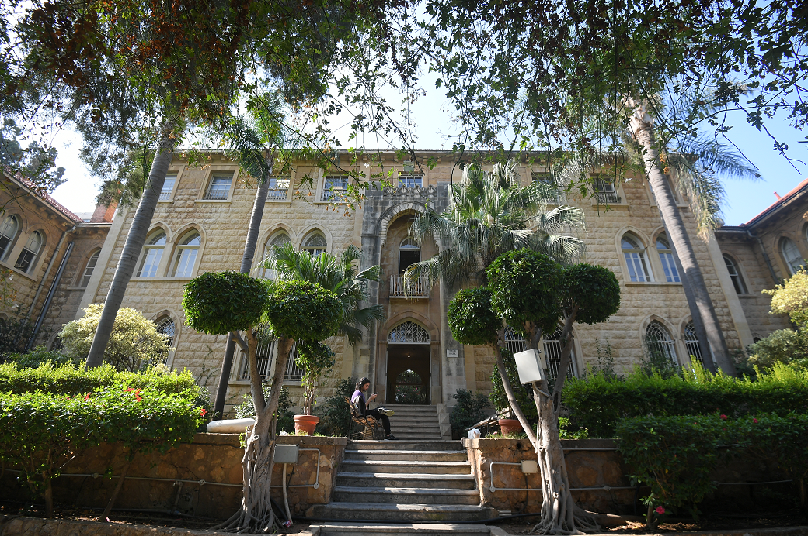
Candidate Profile
Candidate Profile

Slide 5
Ideal Experiences and Qualifications
LAU’s next EVP and Provost will be a successful leader with many of the following attributes, characteristics, and experiences:
Academic stature, with an earned Ph.D. (or equivalent terminal degree) and a distinguished record of scholarship and teaching.
Prior success as an academic leader, with senior administrative leadership experience in a context of significant complexity and commensurate scope and scale and a demonstrated track record of delivering measurable improvements in program quality, research output, and student outcomes, committed to faculty welfare and shared governance.
Program development and execution experience, with the demonstrated capacity to design, secure resources for, and implement innovative academic and/or research initiatives that enhance institutional relevance, impact, and stature.
Team building and leadership, with a track record of attracting and retaining top talent, both academic and administrative.
Strong communication and interpersonal engagement skills, with the ability to effectively partner and build trust with a broad range of stakeholder constituencies.
Operational and financial acumen, with skill in budgeting, faculty workforce planning, and space and research infrastructure development.
Other Personal Attributes:
  Courageous, decisive, and creative. Comfortable leading through ambiguity and complexity, with a bias toward action and innovation.
  Culturally agile and globally minded—thrives in diverse settings and engages stakeholders across borders and disciplines. Knowledgeable about regional and global higher education trends. Familiarity with the Lebanese higher education ecosystem is desirable but not required.
  Clear communicator; able to inspire in public forums and earn trust in small-group settings; communicates tough decisions with empathy.
  Able to focus and lead on important signals and metrics; prioritizes outcomes and impact.

Slide 6
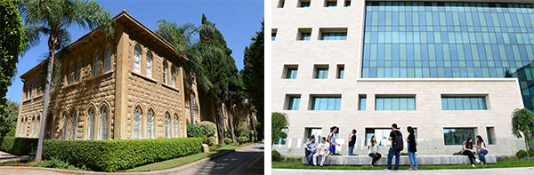

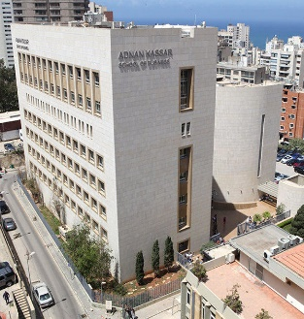




About Lebanese American University

Slide 7
About the Lebanese American University
Lebanese American University—Overview
The University's significant impact is evident through its numbers: over 54,000 alumni across 78 nationalities and 90 countries, more than 9,000 students, and a vast array of extracurricular activities supported by 2,000+ full-time faculty and staff. Its operating budget, including its two medical centers is $368MM and its endowment is around $700MM.
LAU's commitment to accessibility and diversity has been demonstrated in the midst of Lebanon's financial crisis during which the University delivered a $100M financial aid program, unprecedented in the nation's history, so that no eligible student would be turned away on the basis of need. 80% of LAU students benefit from one or more forms of financial aid. Through its endowments, LAU is able to rely on a safety net to address unforeseen issues and access additional resources to support vital areas of the University's development.
Today, the Lebanese American University comprises seven distinct schools:
The School of Arts and Sciences offers a diverse range of programs in humanities, social sciences, natural sciences, and mathematics.
The School of Architecture and Design focuses on innovative and creative design disciplines.
The LAU Adnan Kassar School of Business provides comprehensive business education, emphasizing ethical leadership and global business practices.
The School of Engineering offers engineering programs that blend technical skills with hands-on learning.
The LAU Gilbert and Rose-Marie Chagoury School of Medicine provides medical education and training, emphasizing patient care and research.
The LAU Alice Ramez Chagoury School of Nursing focuses on nursing education and practice, preparing students for healthcare professions.
The School of Pharmacy offers programs in pharmacy practice and pharmaceutical sciences.

Slide 8
About the Lebanese American University
Lebanese American University—Key Facts
LAU has two campuses in Lebanon: Beirut and Byblos. Steeped in history, both cities still bear traces of their ancient origins yet are distinctly modern. Through their libraries, athletic facilities, residence halls, theatres, laboratories, computer centers, and academic support services, the two campuses provide state-of-the-art infrastructure and a wealth of services that enrich the experiences of students, faculty, and staff. The Beirut campus, the University's first, is located in the Ras Beirut neighborhood within steps of the Mediterranean Sea, with 15 buildings ranging from traditional, Ottoman-style architecture to ultra-modern structures. The Beirut campus is a green gem inside a bustling city and is valued by the LAU community, and indeed the nation, for evoking Lebanon's heritage. The Byblos campus, which began development in 1987, represents for many LAUers a combination of modernity, style, and cutting-edge learning. The campus, located near the ancient Phoenician port, has 20 buildings, all constructed with sustainability as well as aesthetics in mind. The campus is home to the health sciences schools as well as the School of Engineering and its high-tech laboratories.
In addition to the two campuses, LAU has expanded its facilities with a strategic presence in Manhattan, New York, with a 2,400-square-meter academic headquarters. Since 2014, this center has been offering courses in Arabic and holding cultural events. This center was recently licensed as a degree-granting campus and will enroll its first class in Fall 2026.
In both planning for its future as well as conducting its ongoing daily activities, LAU seeks to act in a manner that is guided by a deep-rooted sense of shared ethical values and aspirations. Built upon this foundation, Lebanese American University:
Draws its fundamental inspiration from the devotion of its Presbyterian Founders to always seek the Truth, respect human dignity, promote gender equality, and be inclusive;
Provides educational opportunities as one University with multiple campuses, each with distinctive gifts and attributes;
Commits to academic and service excellence throughout the institution;
Demonstrates dignity and respect for and from the Board, faculty, staff, and students in word and in deed;
Celebrates the accomplishments and contributions of all members of the LAU community;
Succeeds because its people take pride of ownership and are held accountable for their actions;
Works together as an extended family community that reflects the highest ethical and moral standards;
Enables individuals to find their own spiritual and personal fulfillment while ever sensitive to the changing global village in which they live; and
Promotes social connectedness of the students to the country of Lebanon and encourages their commitment to social justice and democracy.

Slide 9
The Search Process
The Lebanese American University is being assisted in this recruitment by the international leadership advisory firm Spencer Stuart and welcomes nominations or expressions of interest.
To submit confidential comments, nominations, or expressions of interest, please send an email with any supporting materials to: LAU-Provost@spencerstuart.com

